Slide 1
CSE7000 - INTERNSHIP
A Presentation on
AI Centre of Excellence (Accelerated by NVIDIA)
IntelliPrint Nexus
Student Details
Name | Sufiyan Sameer Shaikh
Roll No | 20241CSE1091
Section | 5CSE15
Under the Supervision of,
Ms. Vineetha B
Assistant Professor
Presidency School of Computer Science and Engineering
Presidency University
Mr. Senthil Kumar H
Assistant Professor
Presidency School of Computer Science and Engineering
Presidency University
Name of the Program: B. Tech (CSE)
Name of the HoD: Dr. Asif Mohamed
Name of the Program Internship Coordinator: Dr. R.Balakrishnan
Name of the School Internship Coordinators: Dr. Bhuvaneshwari Patil

Slide 2
Content
About AI Centre of Excellence – Internship Overview
Problem Statement & Existing System
Proposed IntelliPrint Nexus Solution
System Design & AI Architecture
Implementation & Technology Stack
Results, Dashboards & Performance
Future Scope & Conclusion

Slide 3
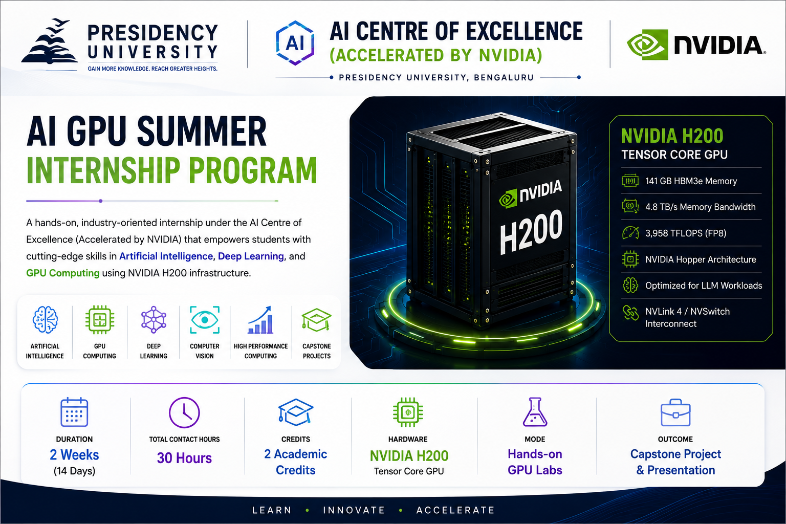
AI Centre of Excellence (Accelerated by NVIDIA) Presidency University | NVIDIA | H200 GPU Computing
The AI Centre of Excellence (Accelerated by NVIDIA) at Presidency University is an advanced research and innovation hub established to promote Artificial Intelligence (AI), Machine Learning (ML), Deep Learning (DL), GPU Computing, and High-Performance Computing (HPC).
The centre provides students with industry-oriented training, hands-on GPU laboratories, and real-world project development opportunities using NVIDIA technologies. It aims to bridge the gap between academic learning and industrial AI applications through practical exposure and innovation-driven education.

Slide 4
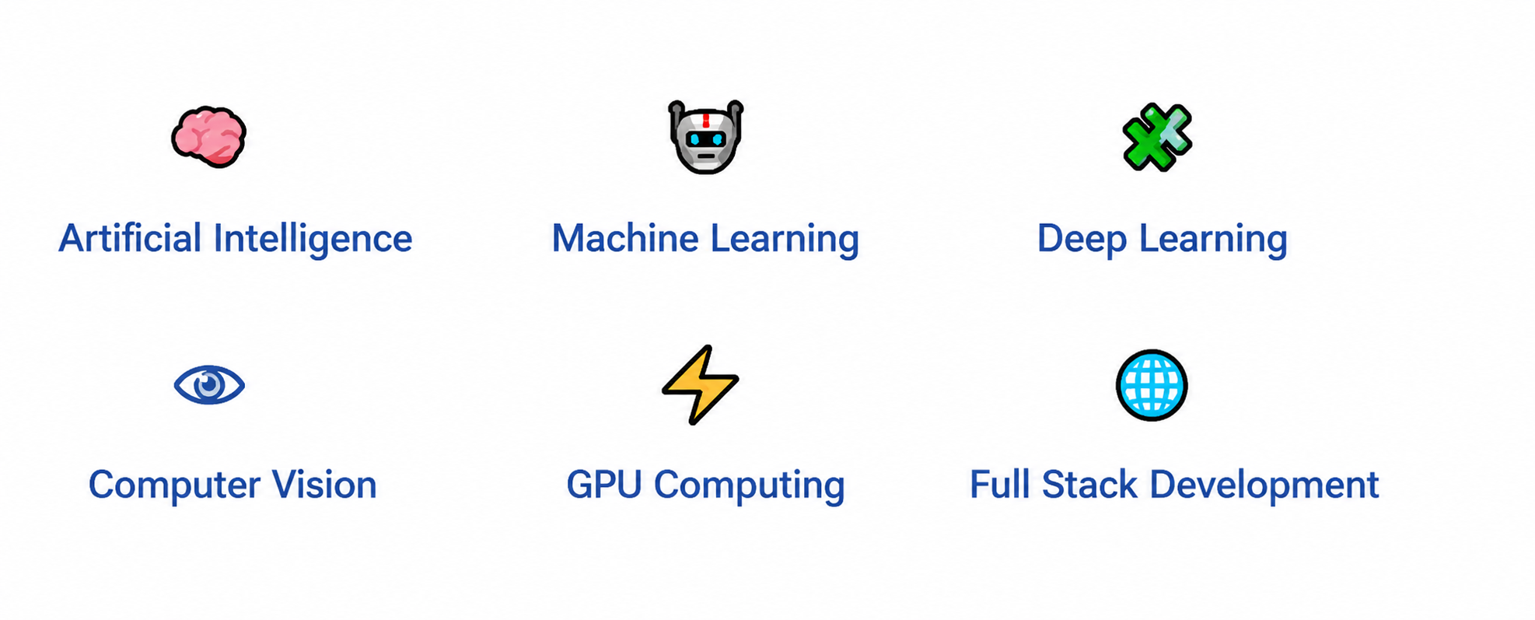
Technical Competencies Acquired During Internship
TECHNOLOGY ECOSYSTEM
CORE LEARNING DOMAINS
🐍 Python →🧠 TensorFlow →👁 OpenCV → ⚡CUDA
↓
🌐 Streamlit →🗄SQLite → 🔗GitHub
Internship Outcome
✔ Built expertise in AI, Deep Learning, Computer Vision, GPU Computing and Full-Stack Development.
✔ Successfully developed IntelliPrint Nexus by integrating AI, intelligent queue optimization and smart printer management.
Hands-on Experience
✔ Developed GPU-accelerated Computer Vision applications using TensorFlow, OpenCV, and NVIDIA H200 infrastructure.

Slide 5
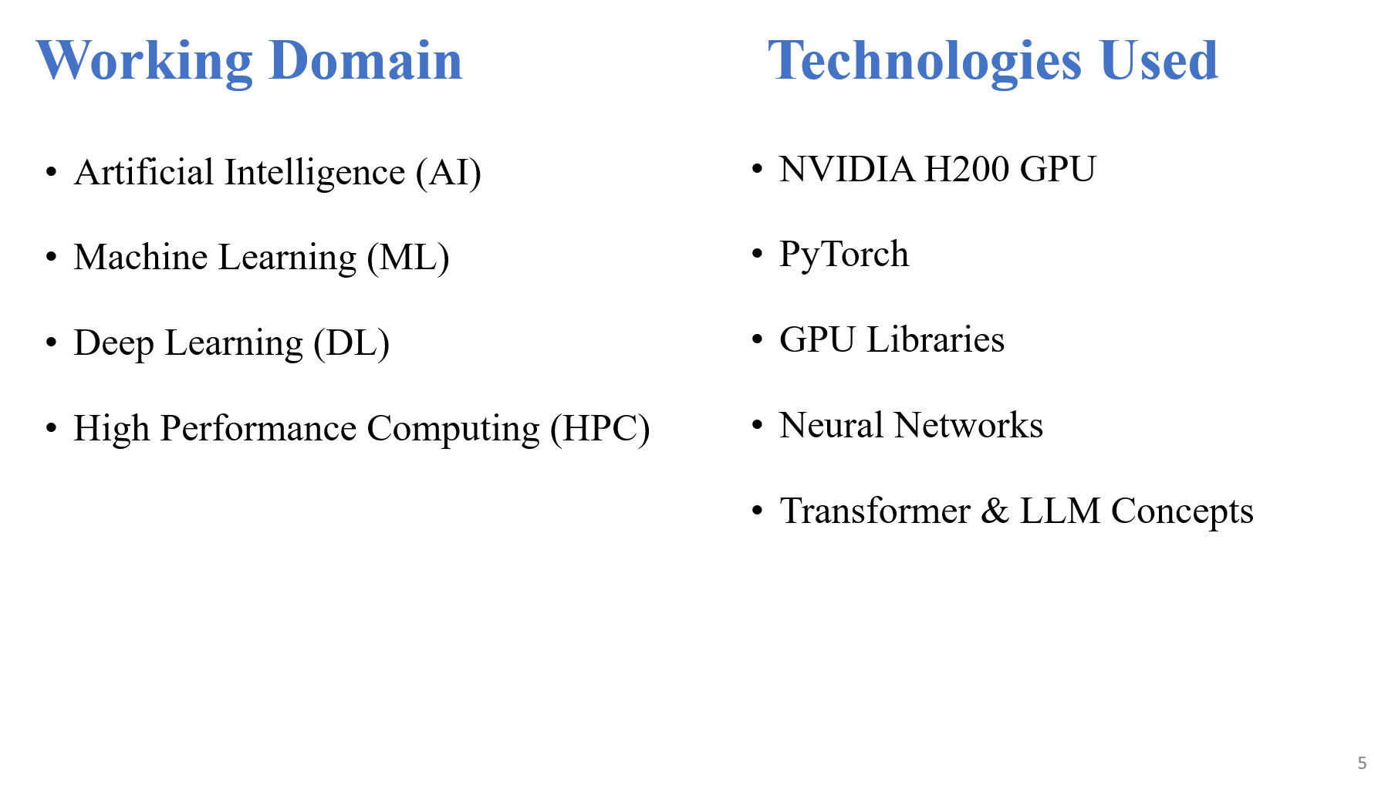

Slide 6
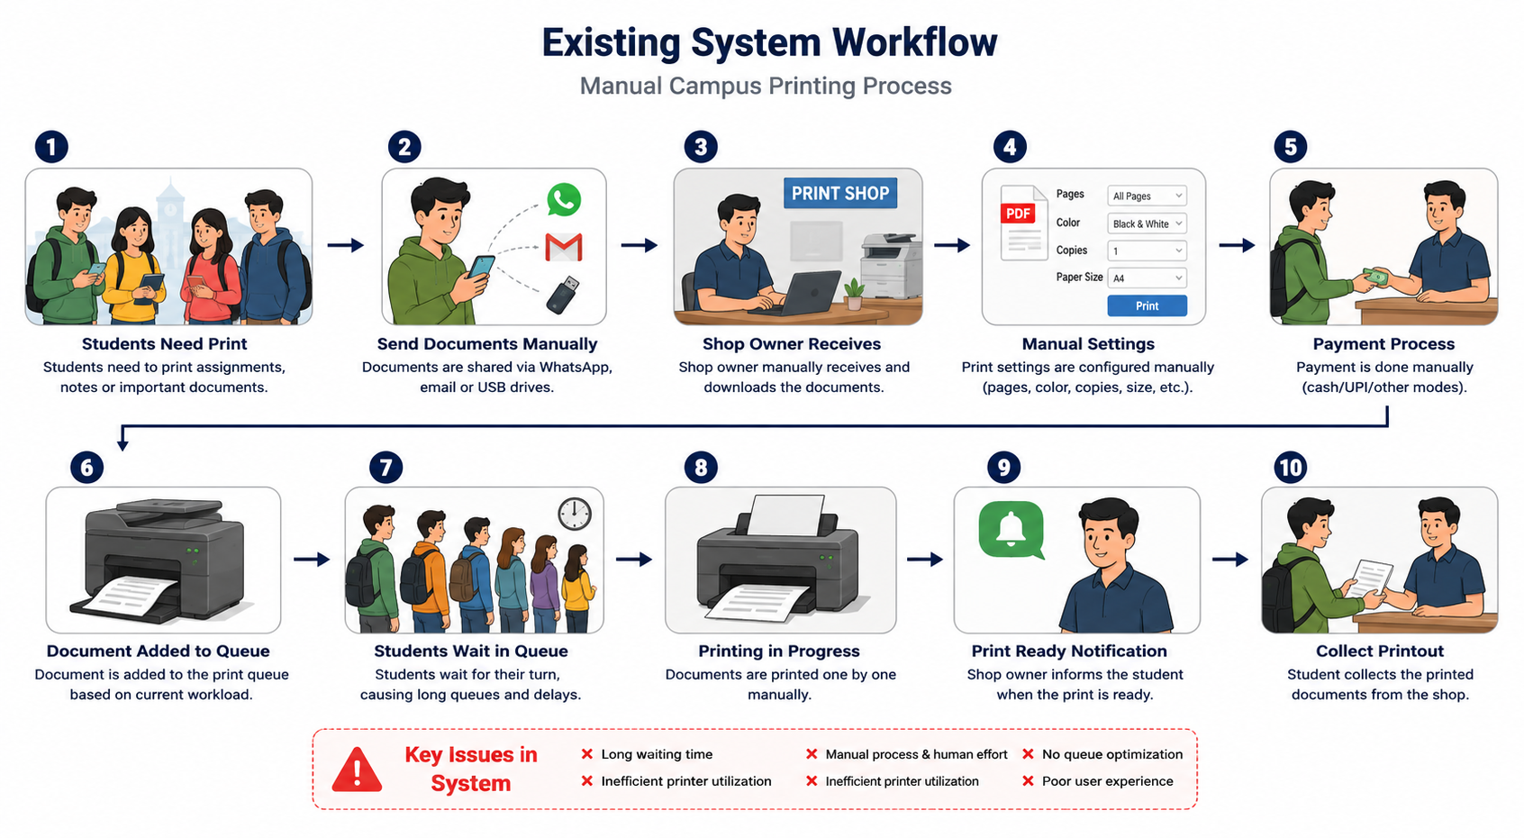
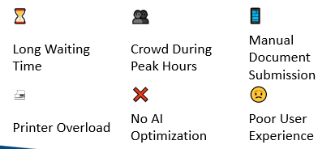
Problem Statement & Existing System
✔ Students experience long waiting queues during class breaks, examination periods, and assignment submissions.
✔ Documents are shared manually through WhatsApp, email, USB drives, or pen drives, increasing processing time.
✔ Shop owners manually configure print settings, printer selection, payment verification, and document handling, causing delays and operational inefficiency.
✔ The absence of AI-based queue optimization, intelligent printer allocation, and real-time job tracking results in poor resource utilization and an unsatisfactory user experience.
Major Challenges

Slide 7
Objectives of the work
Develop An AI-powered Intelligent Campus Printing Solution
Minimize waiting time through intelligent queue management
Improve document quality using AI-based analysis
Enable online document upload and print management
Provide real-time print job tracking and notifications
Enhance campus printing efficiency and user experience

Slide 8
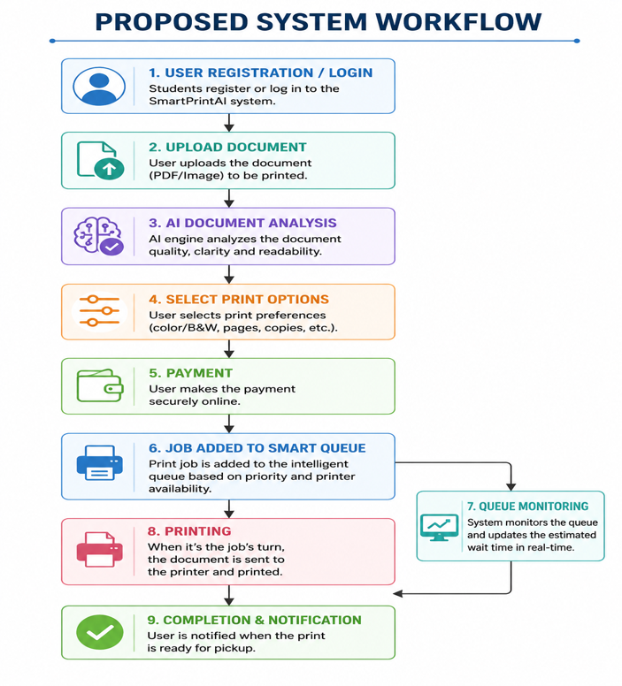
Methodology Used – Project Workflow
Proposed IntelliPrint Nexus Solution
Proposed IntelliPrint Nexus Workflow
KEY FEATURES
🤖 AI Document Analysis ⏱ Queue Prediction
🖨 Smart Printer Allocation 💳 Secure Payment
📱 Real-Time Tracking 📄 QR Code Collection
📊 Admin Dashboard ☁ Automated Workflow
IntelliPrint Nexus combines Artificial Intelligence, Machine Learning, Deep Learning, Computer Vision, and Full-Stack Development to deliver an intelligent, secure, and efficient campus printing ecosystem.

Slide 9
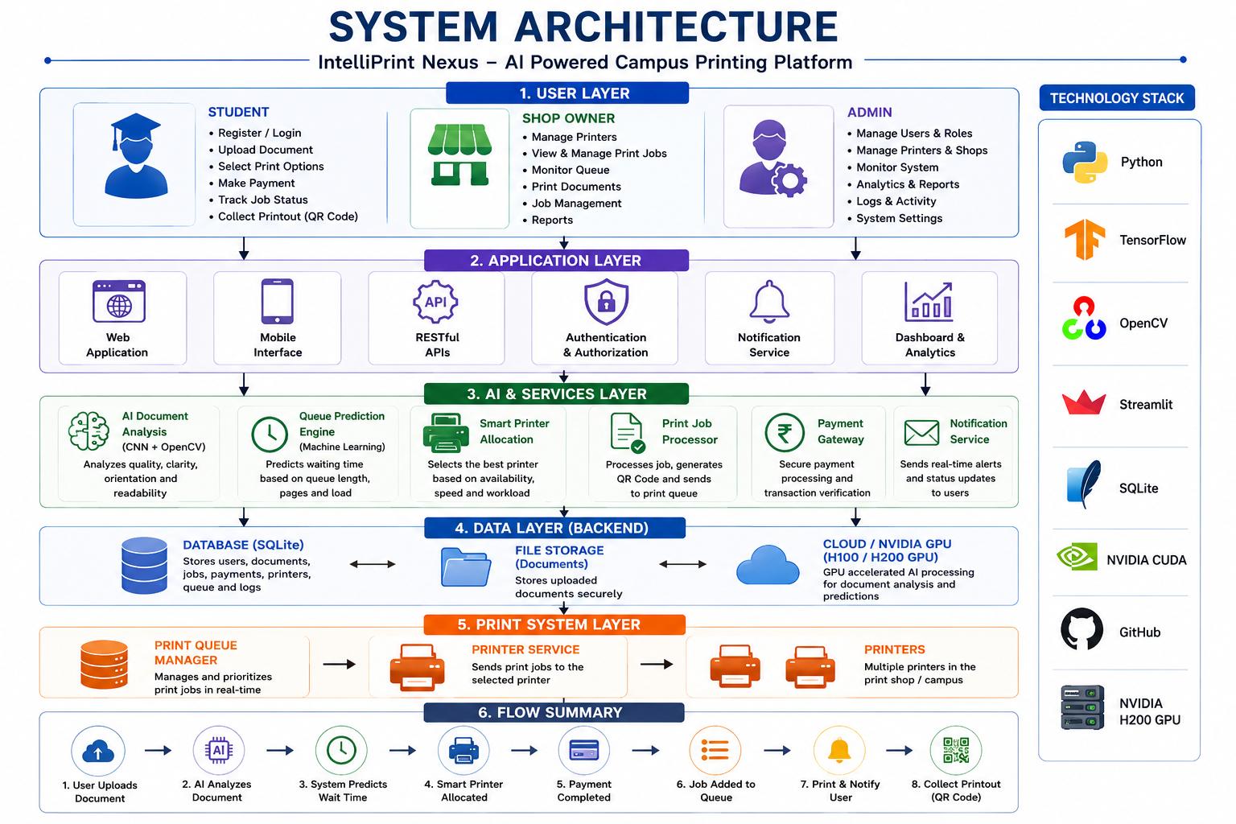
Methodology Used – System Architecture
Architecture Components
User Layer (Students, Shop Owner & Admin)
Application Layer (Authentication & Dashboard)
AI & Service Layer (Document Analysis & Queue Prediction)
Data Layer (Database & File Storage)
Print Management Layer (Queue & Printer Services)
GPU Computing Layer (TensorFlow, CUDA & NVIDIA H200)

Slide 10
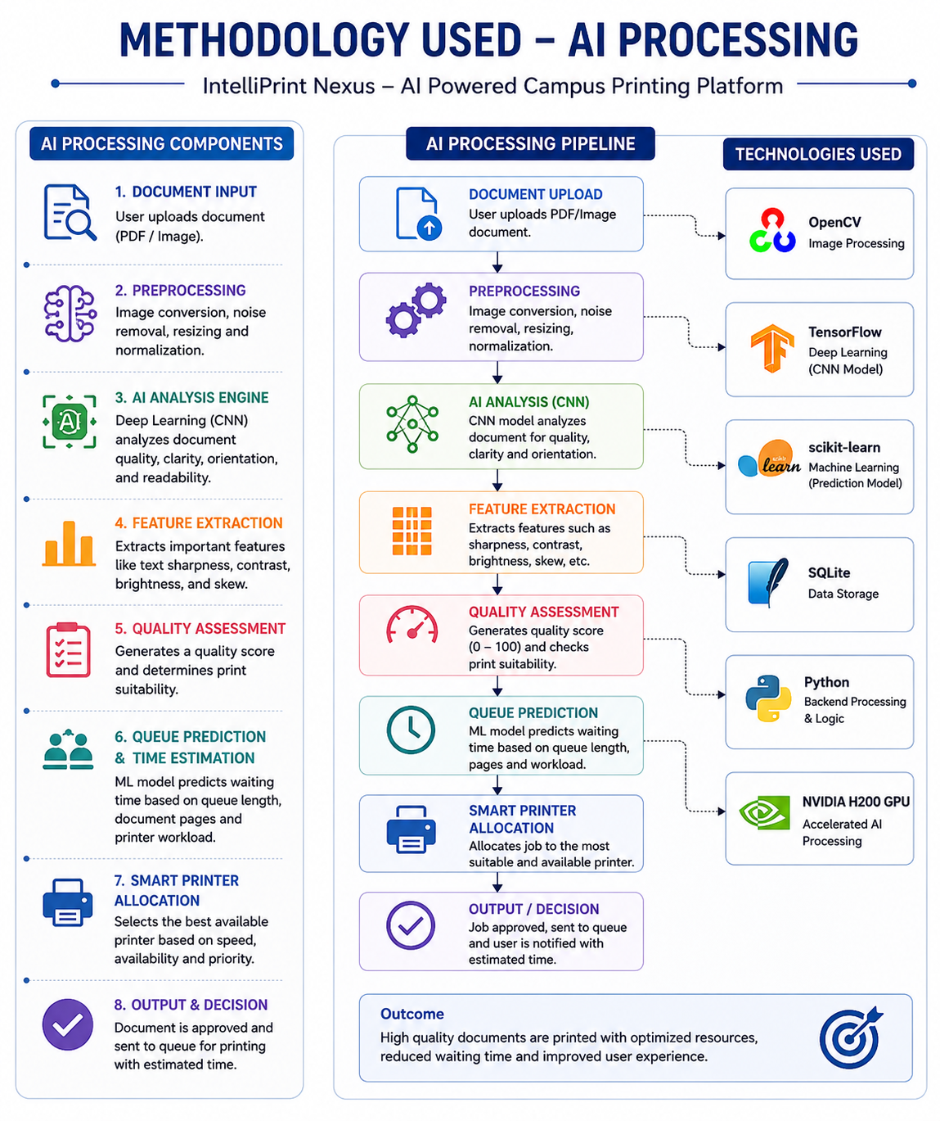
Methodology Used – AI Processing
AI Processing Steps
TensorFlow – CNN Model Training
OpenCV – Image Processing
Machine Learning – Queue Prediction
Random Forest / XGBoost – Waiting Time Estimation
NVIDIA CUDA – GPU Acceleration
Python – AI Workflow Integration

Slide 11
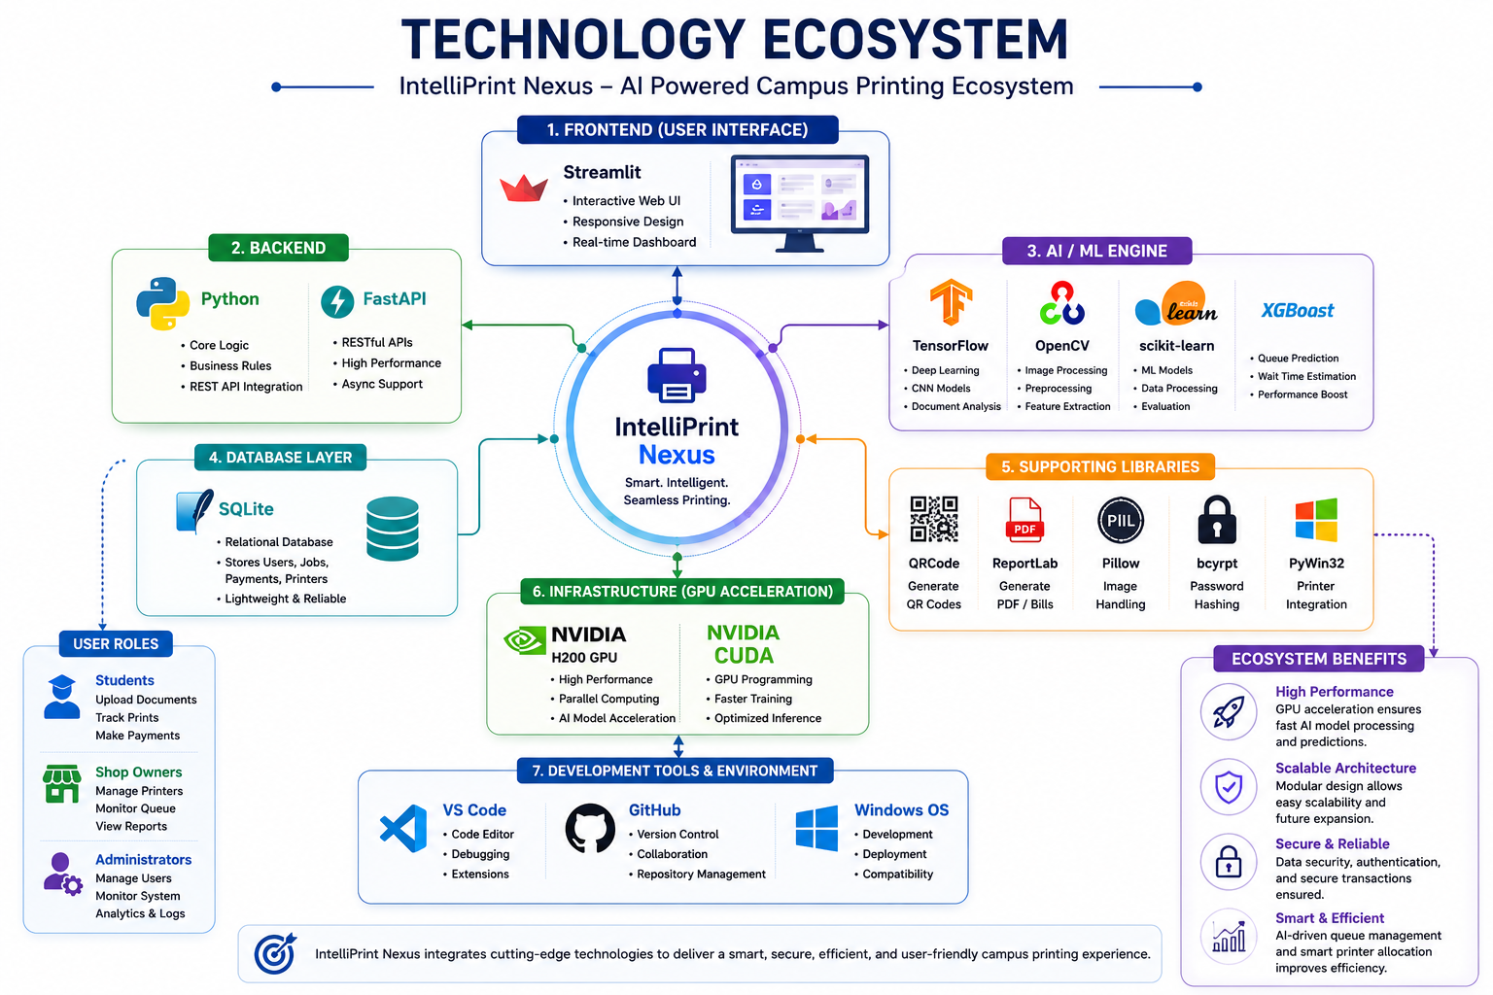
Technology Stack
Technology Stack Overview
Presentation Layer – Interactive web application developed using Streamlit.
Application Layer – Core business logic implemented in Python with modular architecture.
AI & Analytics Layer – TensorFlow, OpenCV, Scikit-learn, and XGBoost enable intelligent document analysis and queue optimization.
Data Layer – SQLite and SQLAlchemy provide secure and efficient database management.
Integration Layer – Supporting libraries facilitate QR generation, PDF creation, authentication, and printer communication.
Infrastructure Layer – VS Code, GitHub, NVIDIA H200 GPU, and CUDA support efficient development, version control, and GPU-accelerated AI computing.

Slide 12
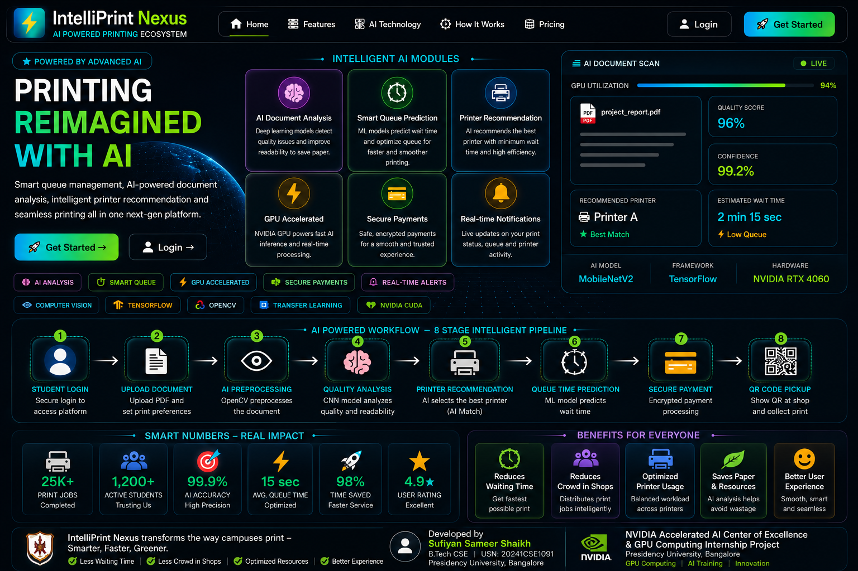
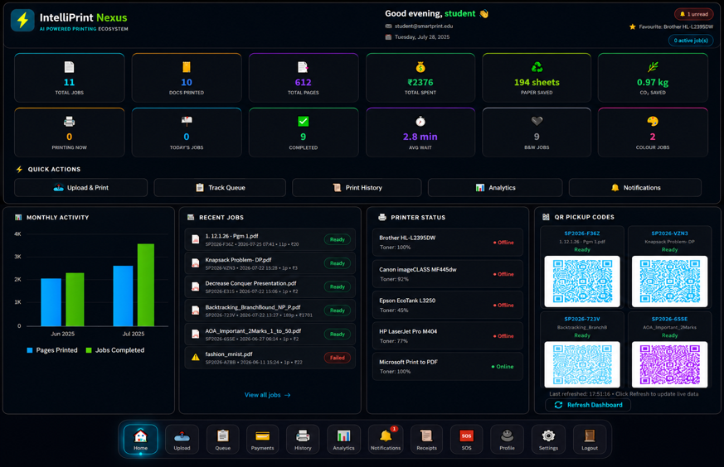
Results
RESULTS & SYSTEM DEMONSTRATION
Landing Page
Student Dashboard
Modern AI-Powered Campus Printing Interface
Document Upload & Print Management

Slide 13
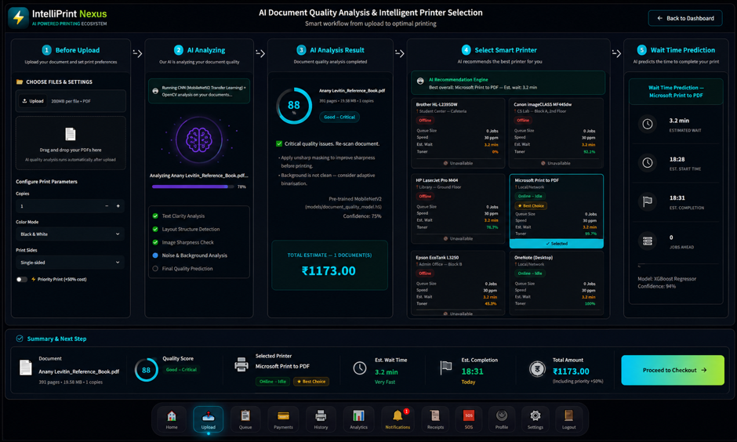
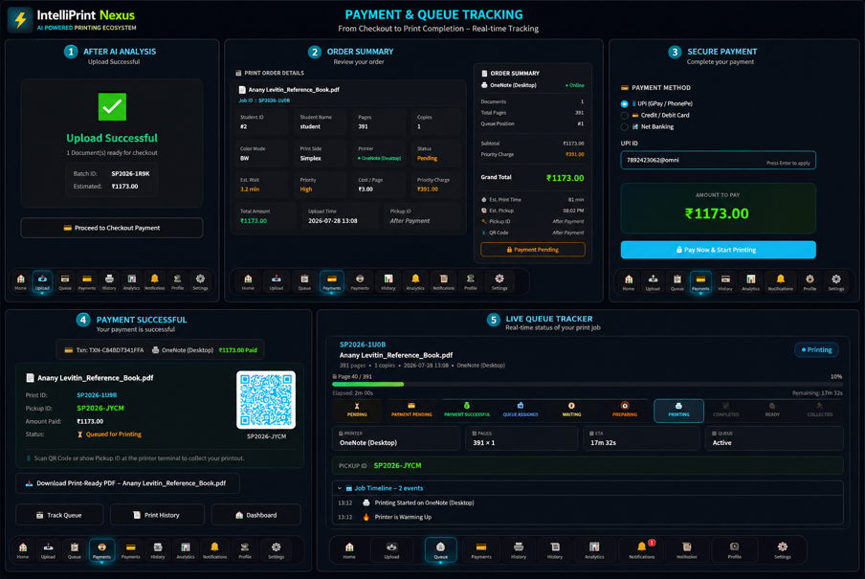
AI Document Analysis
Queue / Payment / QR Code
CNN-Based Document Quality Assessment
Real-Time Queue Tracking & Secure Print Collection

Slide 14
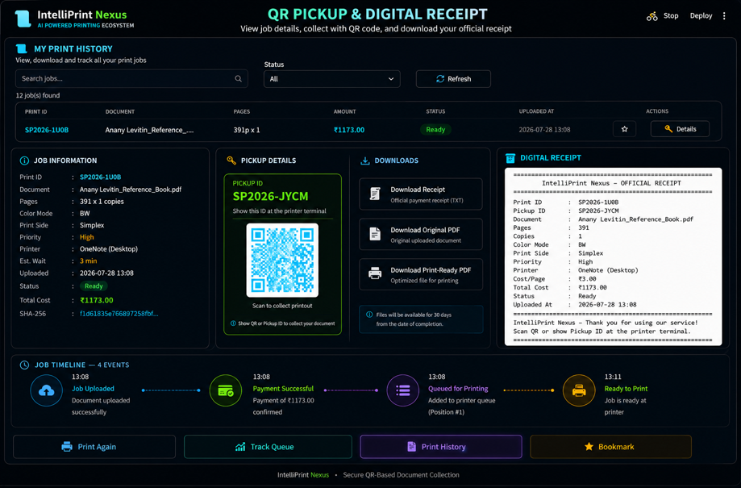
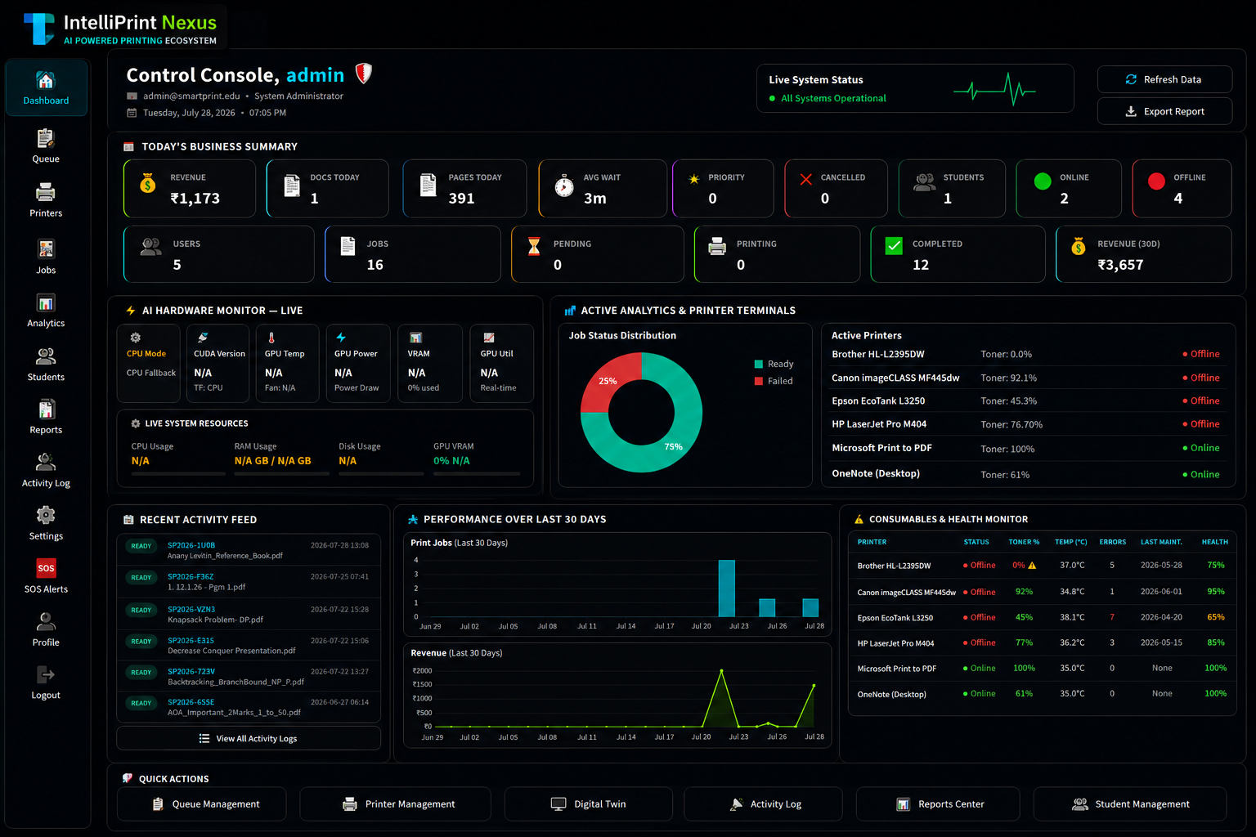
QR Based Document Pickup
Super Admin Dashboard
Unique QR Or Pickup ID Based Document Collecting
Platform Monitoring & Analytics

Slide 15
Conclusion
Successfully designed and developed IntelliPrint Nexus, an AI-Powered Campus Printing Network for intelligent print management.
Integrated Artificial Intelligence, Machine Learning, Deep Learning, Computer Vision, and GPU Computing to automate document quality analysis and optimize printing operations.
Implemented intelligent queue prediction, smart printer allocation, secure digital payment, and QR Code–based document collection to enhance operational efficiency.
Reduced manual intervention, minimized waiting time, improved resource utilization, and delivered a seamless printing experience for students and print shop owners.
Established a scalable and modular platform that supports future enhancements including cloud deployment, IoT-enabled smart printers, mobile applications, predictive maintenance, and Large Language Model (LLM) integration.
Demonstrated the practical application of NVIDIA GPU Computing and Modern AI Technologies in solving a real-world Smart Campus problem.

Slide 16

Q&A

Slide 17
Thank you !!

